Slide 1
GAM 325/425: Applied 3D Geometry
Lecture 10:
Interpolation

Slide 2
Part I:
General Overview

Slide 3
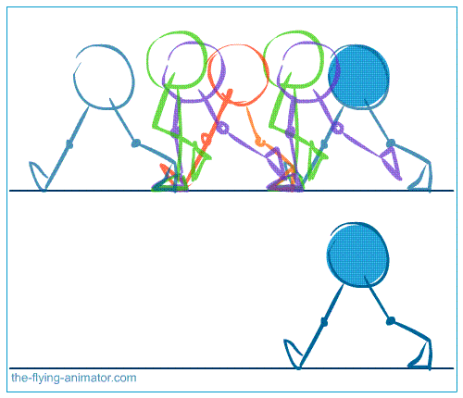
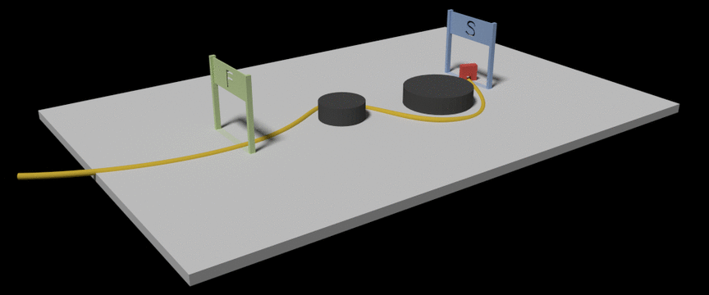
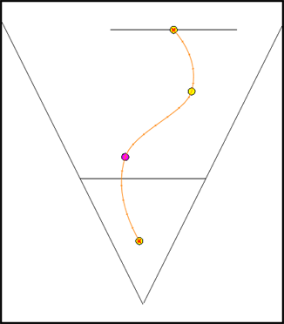
Animation and Paths
Consider typical animation or paths used for games/animation.
In either case:
Key information (position, rotation, scale) is specified by the artist/designer
In other words, we have little to no control over how the asset is created
We only get the information at specific points in time/space.
Ex: From the above: the path has only 4 key points and the walk loop has 7 key ‘frames’
The game engine must compute the correct information in between these key values
Ex 1: For path: Based on the speed of the red block, what is it’s position/orientation at 1.3s?
Ex 2: Walk loop: Base on walking speed, what are the legs/joints position/orientation at 2.6s?

Slide 4
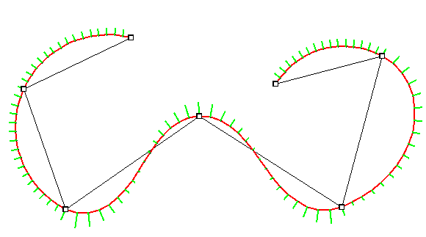
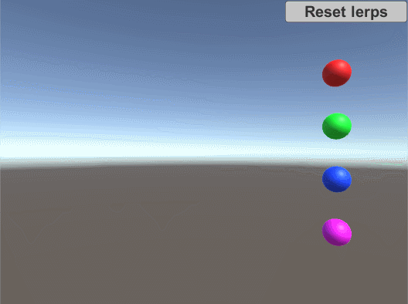
Interpolation
Interpolation is a method to construct a new value within a set of known data points.
Example:
The 7 squares are the known data points
The grey line represents a pair-wise linear
interpolation
The orange line represents a different type
of interpolation
Clearly:
There are more than one interpolation method available
Different interpolation methods result in different curves
Animation flourishes like acceleration & damping are NOT part of interpolation:
They are implemented using the data from the computed interpolated path itself.

Slide 5
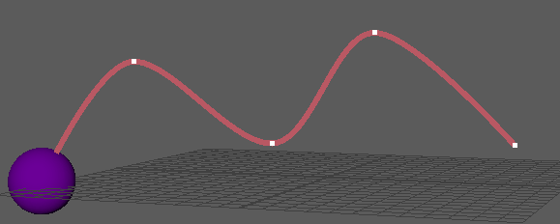
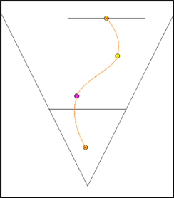
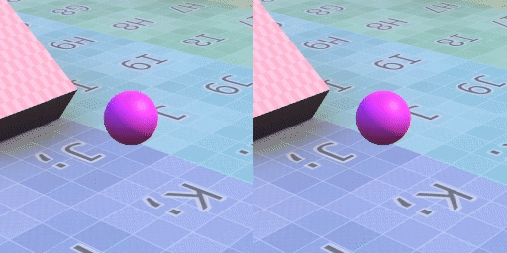
Interpolation
One problem with interpolation: correctly reproducing the original curve.
Typical example:
Artist create some animation:
Done using Maya, 3ds Max,etc
Data points are exported (with some information about technique):
Data is loaded in computer (we hope we can reproduce the technique):
Computer uses data to reproduce animation (does it match?)
In general, we need to determine which interpolation method was used by whatever software used to create the asset…
Or at least find one that the designer/artist deems ‘close enough’
Rendered vs Expected

Slide 6
Part II:
Matrix Representation and
Linear Interpolation

Slide 7
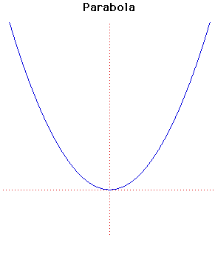
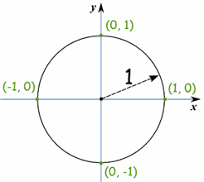
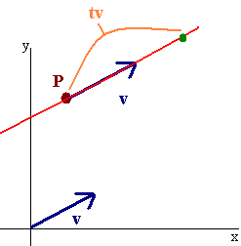
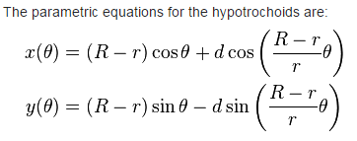
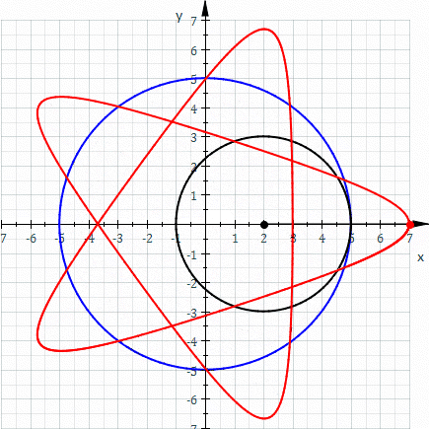
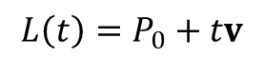
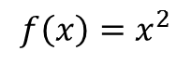
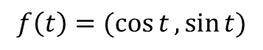
Parametric Curve
A parametric curve expresses the points of a curve as a function of a variable (the parameter)
Examples:
Side note: In general, parametric curves could have multiple parameters, but one will suffice for our purposes here
$$f\left(x\right)=x^{2}$$
$$f\left(t\right)=(\cos{t},\sin{t})$$
$$L\left(t\right)=P_{0}+tv$$

Slide 8
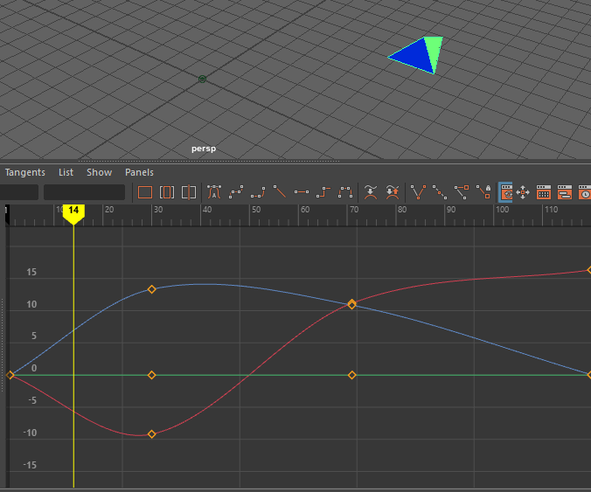
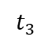
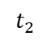
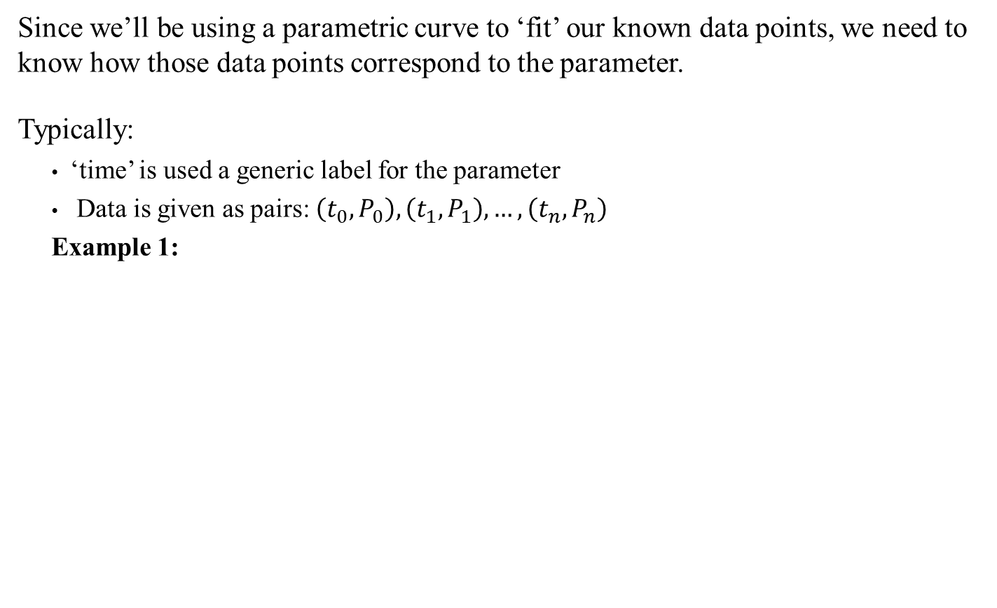
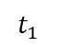
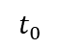
Data Points and Parametric Curve
Since we’ll be using a parametric curve to ‘fit’ our known data points, we need to know how those data points correspond to the parameter.
Typically:
‘time’ is used a generic label for the parameter
Data is given as pairs: $\left(t_{0}, P_{0}\right),\left(t_{1}, P_{1}\right), …,\left(t_{n}, P_{n}\right)$
Example 1:
$$t_{0}$$
$$t_{1}$$
$$t_{2}$$
$$t_{3}$$
At t = 0, pos = (0, 0, 0)
At t = 30, pos = (-9, 0, 13)
At t = 71, pos = (11, 0, 11)
At t = 120, pos = (16, 0, 0)

Slide 9
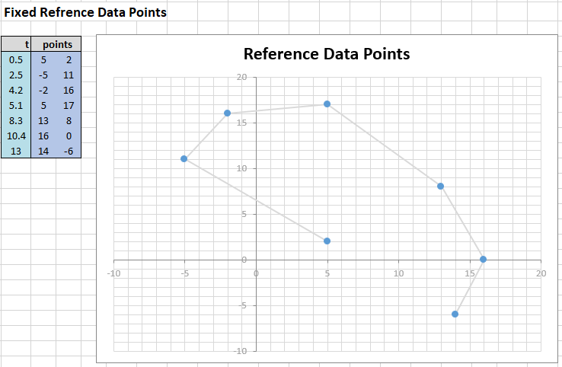
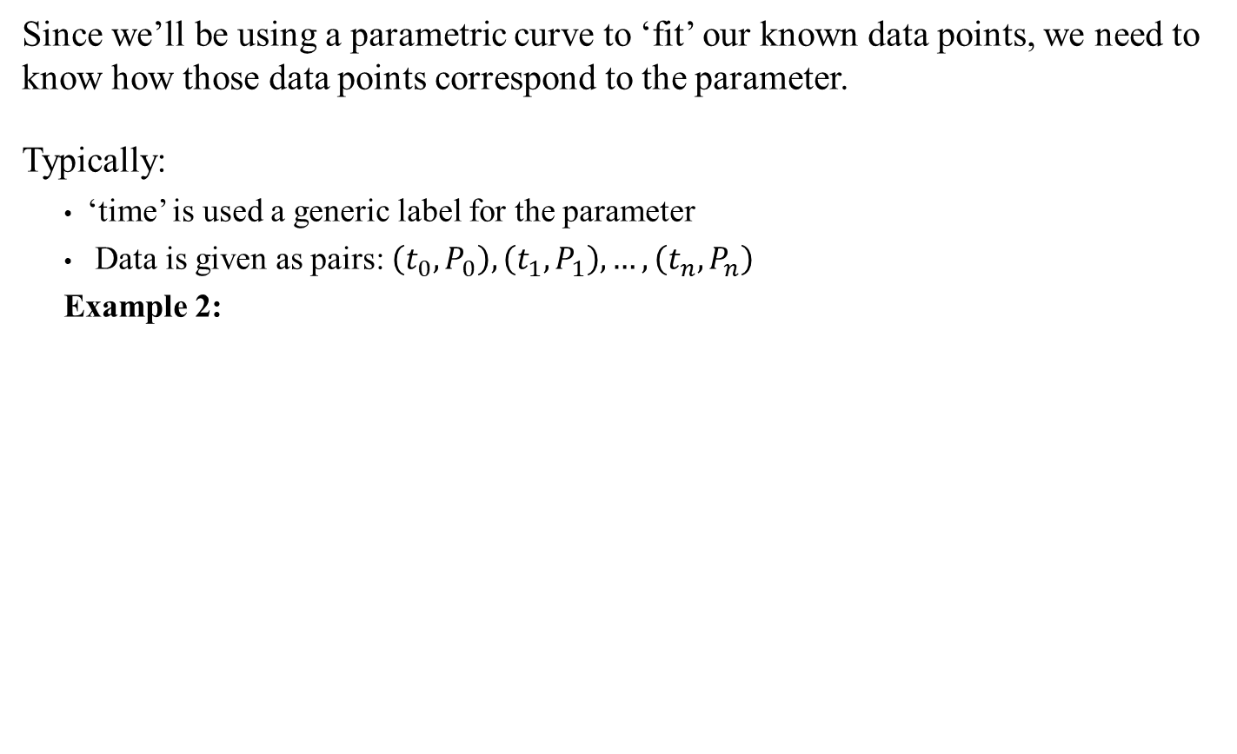
Data Points and Parametric Curve
Since we’ll be using a parametric curve to ‘fit’ our known data points, we need to know how those data points correspond to the parameter.
Typically:
‘time’ is used a generic label for the parameter
Data is given as pairs: $\left(t_{0}, P_{0}\right),\left(t_{1}, P_{1}\right), …,\left(t_{n}, P_{n}\right)$
Example 2:
At t = 0.5, pos = (5,2)
At t = 2.5, pos = (-5,11)
etc.
Important:
In general, the list can often contain many 100s of data point!

Slide 10
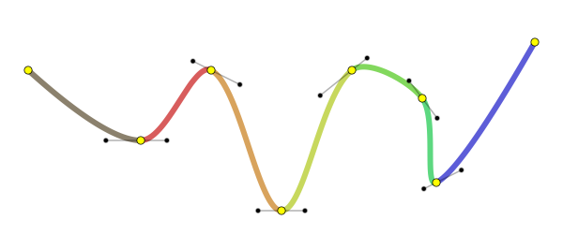
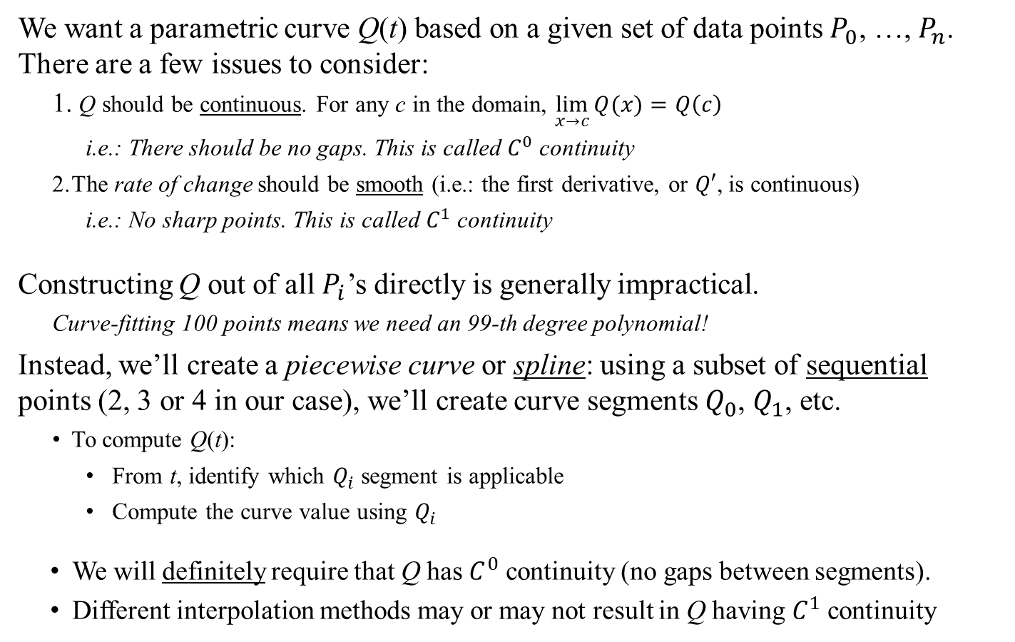
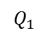
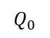
Parametric Curve and Interpolation
We want a parametric curve Q(t) based on a given set of data points $P_{0}$, …, $P_{n}$. There are a few issues to consider:
Q should be continuous. For any c in the domain, $\lim_{x→c}{Q(x)}=Q\left(c\right)$
i.e.: There should be no gaps. This is called $C^{0}$ continuity
The rate of change should be smooth (i.e.: the first derivative, or $Q′$, is continuous)
i.e.: No sharp points. This is called $C^{1}$ continuity
Constructing Q out of all $P_{i}$’s directly is generally impractical.
Curve-fitting 100 points means we need an 99-th degree polynomial!
Instead, we’ll create a piecewise curve or spline: using a subset of sequential points (2, 3 or 4 in our case), we’ll create curve segments $Q_{0}$, $Q_{1}$, etc.
To compute Q(t):
From t, identify which $Q_{i}$ segment is applicable
Compute the curve value using $Q_{i}$
We will definitely require that Q has $C^{0}$ continuity (no gaps between segments).
Different interpolation methods may or may not result in Q having $C^{1}$ continuity
Side note: Yes, we need a little bit of calculus for today’s lecture. Hopefully it won’t be too bad…
$$Q_{0}$$
$$Q_{1}$$

Slide 11
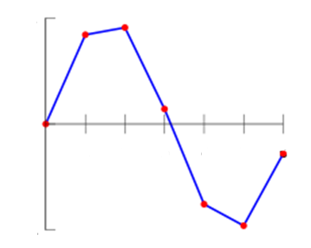
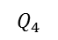
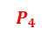
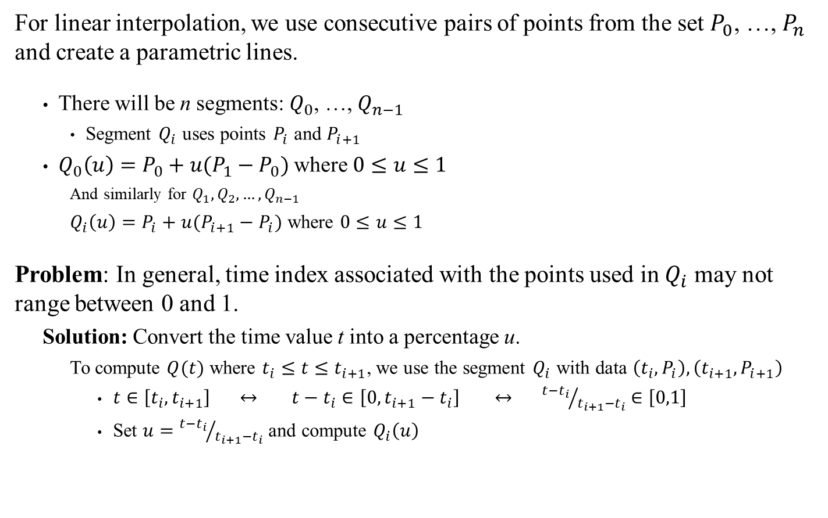
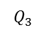
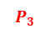
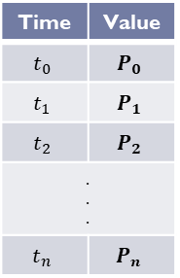

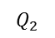

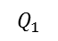
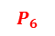
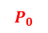
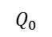
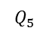
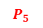
Linear Spline Interpolation
For linear interpolation, we use consecutive pairs of points from the set $P_{0}$, …, $P_{n}$ and create a parametric lines.
There will be n segments: $Q_{0}$, …, $Q_{n−1}$
Segment $Q_{i}$ uses points $P_{i}$ and $P_{i+1}$
$Q_{0}\left(u\right)=P_{0}+u(P_{1}−P_{0})$ where $0≤u≤1$
And similarly for $Q_{1},Q_{2},…,Q_{n−1}$
$Q_{i}\left(u\right)=P_{i}+u(P_{i+1}−P_{i})$ where $0≤u≤1$
Problem: In general, time index associated with the points used in $Q_{i}$ may not range between 0 and 1.
Solution: Convert the time value t into a percentage u.
To compute $Q(t)$ where $t_{i}≤t≤t_{i+1}$, we use the segment $Q_{i}$ with data $\left(t_{i}, P_{i}\right),\left(t_{i+1}, P_{i+1}\right)$
$t∈\left[t_{i}, t_{i+1}\right]$ $↔$ $t−t_{i}∈\left[0, t_{i+1}−t_{i}\right]$ $↔$ ${t−t_{i}}/{t_{i+1}−t_{i}}∈\left[0,1\right]$
Set $u={t−t_{i}}/{t_{i+1}−t_{i}}$ and compute $Q_{i}\left(u\right)$
$$Q_{1}$$
$$P_{2}$$
Time | Value
$$t_{0}$$ | $$P_{0}$$
$$t_{1}$$ | $$P_{1}$$
$$t_{2}$$ | $$P_{2}$$
. . .
$$t_{n}$$ | $$P_{n}$$
$$Q_{0}$$
$$P_{1}$$
$$Q_{2}$$
$$P_{3}$$
$$P_{0}$$
$$Q_{3}$$
$$P_{6}$$
$$P_{4}$$
$$Q_{5}$$
$$Q_{4}$$
$$P_{5}$$
Simple enough… Now let’s look at some implementation/notation details

Slide 12
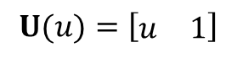
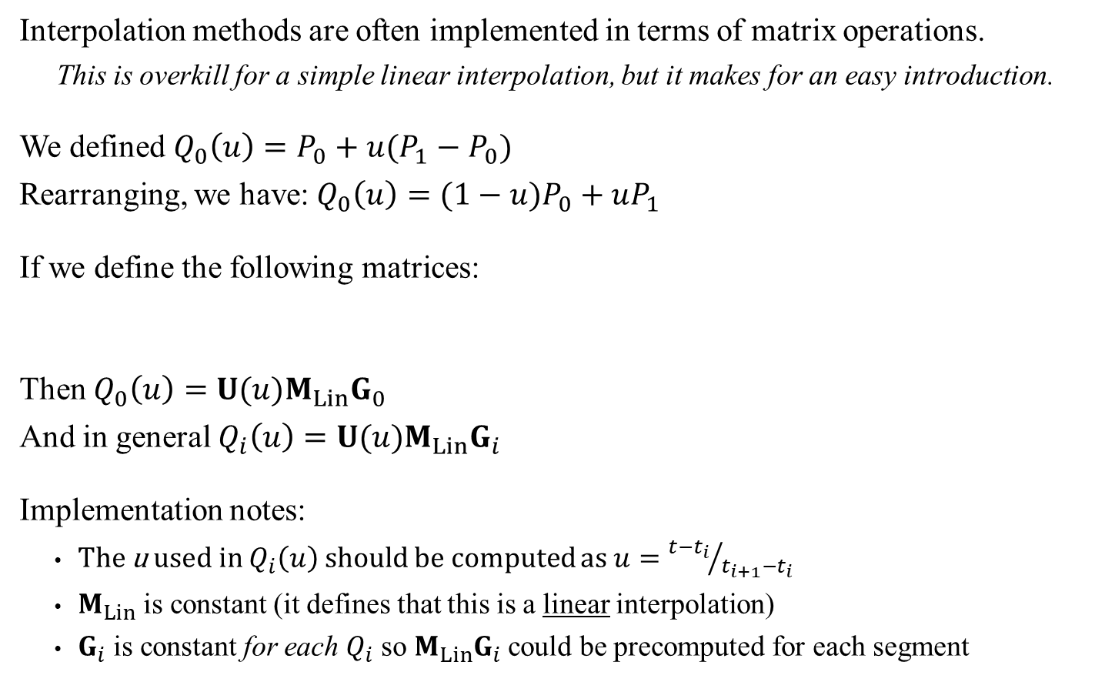
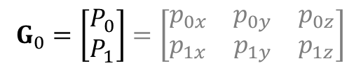
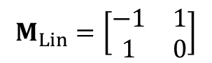
Interpolation And Matrix Representation
Interpolation methods are often implemented in terms of matrix operations.
This is overkill for a simple linear interpolation, but it makes for an easy introduction.
We defined $Q_{0}\left(u\right)=P_{0}+u(P_{1}−P_{0})$
Rearranging, we have: $Q_{0}\left(u\right)=(1−u)P_{0}+uP_{1}$
If we define the following matrices:
Then $Q_{0}\left(u\right)=U(u)M_{Lin}G_{0}$
And in general $Q_{i}\left(u\right)=U(u)M_{Lin}G_{i}$
Implementation notes:
The u used in $Q_{i}\left(u\right)$ should be computed as $u={t−t_{i}}/{t_{i+1}−t_{i}}$
$M_{Lin}$ is constant (it defines that this is a linear interpolation)
$G_{i}$ is constant for each $Q_{i}$ so $M_{Lin}G_{i}$ could be precomputed for each segment
Warning!
The points are in row not column!
$$U(u)=\left[\begin{matrix}u & 1\end{matrix}\right]$$
$$M_{Lin}=\left[\begin{matrix}−1 & 1 \\ 1 & 0\end{matrix}\right]$$
$$G_{0}=\left[\begin{matrix}P_{0} \\ P_{1}\end{matrix}\right]=\left[\begin{matrix}p_{0x} & p_{0y} & p_{0z} \\ p_{1x} & p_{1y} & p_{1z}\end{matrix}\right]$$
Side note: The book uses generic matrices U, M and G without any references to the parameter u, the segment index or even the interpolation method. I consider that bad form.

Slide 13

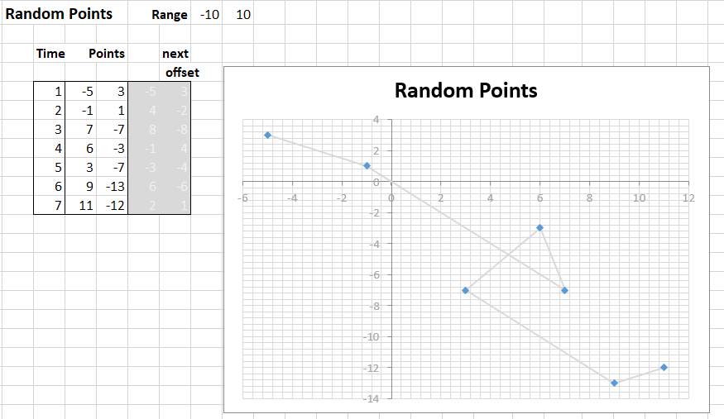
Interpolation Simulator
Instead of a homework this week, you’ll have access to an interpolation simulator in the weekly dynamic examples.
I’ve made some attempts at making it user-friendly, but still… use your brain.
Most of the spreadsheet is locked-out
The only ‘input areas’ are the light-blue cells and radio buttons
There are 5 tabs to select at the bottom:
Data Tab:
Data set used by all other tabs. (Pairs of time value and 2D points)
You can also cut-&-paste (paste as value!) from the random data generator on the right
Paste
as value!
See also Dynamic Examples

Slide 14
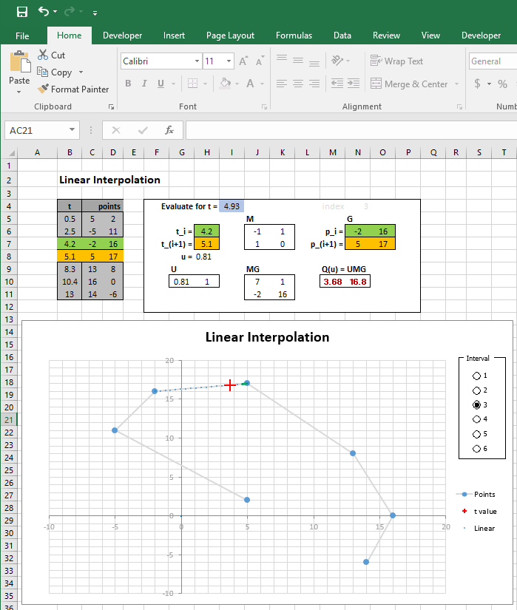
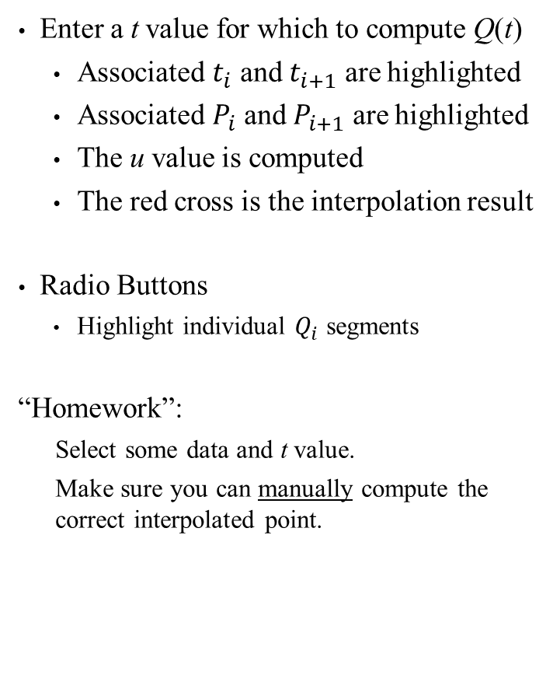
Simulator: Linear Interpolation
Enter a t value for which to compute Q(t)
Associated $t_{i}$ and $t_{i+1}$ are highlighted
Associated $P_{i}$ and $P_{i+1}$ are highlighted
The u value is computed
The red cross is the interpolation result
Radio Buttons
Highlight individual $Q_{i}$ segments
“Homework”:
Select some data and t value.
Make sure you can manually compute the correct interpolated point.

Slide 15
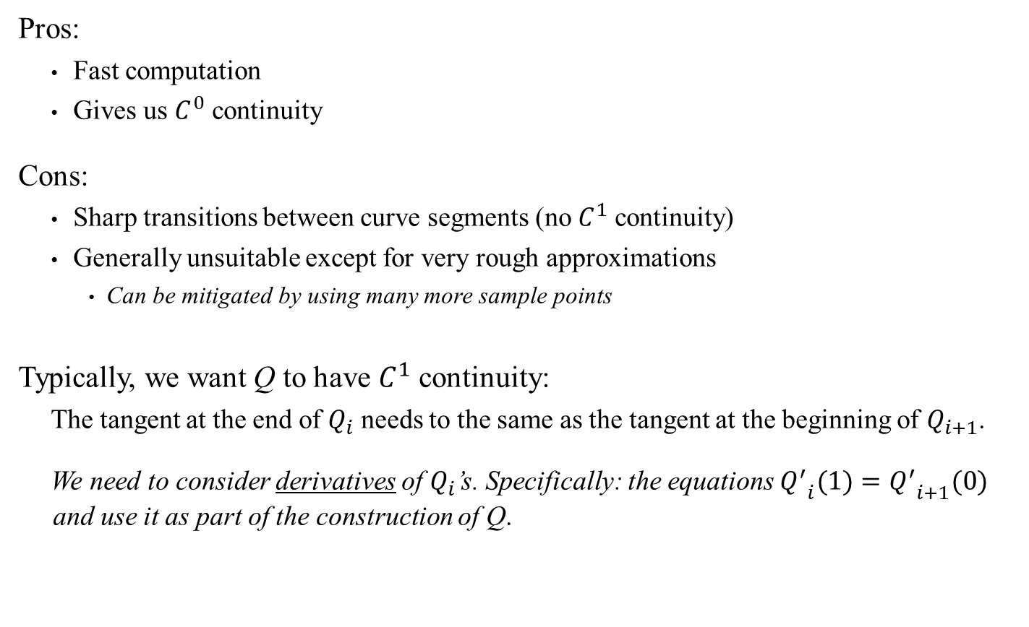
Linear Spline Interpolation
Pros:
Fast computation
Gives us $C^{0}$ continuity
Cons:
Sharp transitions between curve segments (no $C^{1}$ continuity)
Generally unsuitable except for very rough approximations
Can be mitigated by using many more sample points
Typically, we want Q to have $C^{1}$ continuity:
The tangent at the end of $Q_{i}$ needs to the same as the tangent at the beginning of $Q_{i+1}$.
We need to consider derivatives of $Q_{i}$’s. Specifically: the equations ${Q^{′}}_{i}(1)={Q^{′}}_{i+1}(0)$ and use it as part of the construction of Q.

Slide 16
Part III:
Hermite Splines

Slide 17









Hermite Curve
$${P′}_{1}$$
Hermite curves are cubic curves defined by
Two end points $P_{0}$ and $P_{1}$
Two tangents at those points, labelled ${P′}_{0}$ and ${P′}_{1}$
Let’s look at a generic parametric Hermite curve Q:
Q is a cubic function: $Q\left(u\right)=au^{3}+bu^{2}+cu+d$
We want $Q\left(0\right)=P_{0}$ and $Q\left(1\right)=P_{1}$
Q’s derivative is $Q′\left(u\right)=3au^{2}+2bu+c$
we want $Q^{′}\left(0\right)={P′}_{0}$ and $Q^{′}\left(1\right)={P′}_{1}$
$${P′}_{0}$$
$$P_{1}$$
$$P_{0}$$
$$Q\left(0\right)=d=P_{0}$$
$$Q\left(1\right)=a+b+c+d=P_{1}$$
$$Q′\left(0\right)=c={P′}_{0}$$
$$Q′\left(1\right)=3a+2b+c={P′}_{1}$$
This is just a system of 4 linear equations with 4 unknowns (a, b, c and d). We can solve this

Slide 18










Hermite Curve
Solving the following for a, b, c and d:
Gives:
Which, in matrix form, gives: $Q\left(u\right)=U(u)M_{Herm}G_{0}$ where
But: this only tells us how to compute a single segment. We still need to assemble the segments into a proper spline.
$$c={P′}_{0}$$
$$a+b+c+d=P_{1}$$
$$d=P_{0}$$
$$3a+2b+c={P′}_{1}$$
Or alternatively:
$$Q\left(u\right)=\left(2u^{3}−{3u}^{2}+1\right)P_{0}$$
$+\left(−2u^{3}+{3u}^{2}\right)P_{1}$
$+\left(u^{3}−{2u}^{2}+u\right){P′}_{0}$
$+\left(u^{3}−u^{2}\right){P′}_{1}$
$$Q\left(u\right)=\left[2\left(P_{0}−P_{1}\right)+{P^{′}}_{0}+{P^{′}}_{1}\right]u^{3}$$
$+\left[3\left(P_{1}−P_{0}\right)−2{P^{′}}_{0}−{P^{′}}_{1}\right]u^{2}$
$+{P′}_{0}u$
$+P_{0}$
$$M_{Herm}=\left[\begin{matrix}2 & −2 & 1 & 1 \\ −3 & 3 & −2 & −1 \\ 0 & 0 & 1 & 0 \\ 1 & 0 & 0 & 0\end{matrix}\right]$$
$$G_{0}=\left[\begin{matrix}P_{0} \\ P_{1} \\ {P′}_{0} \\ {P′}_{1}\end{matrix}\right]$$
$$U(u)=\left[\begin{matrix}u^{3} & u^{2} & u & 1\end{matrix}\right]$$

Slide 19









Hermite Splines
See also Hermit Splines on Wikipedia
From the previous slides: if we have n curve segments, each being computed by a parametrized Hermite curve, then we have
$Q_{i}\left(u\right)=U\left(u\right)M_{Herm}G_{i}=U\left(u\right)M_{Herm}\left[\begin{matrix}P_{i} \\ P_{i+1} \\ {P′}_{i} \\ {P′}_{i+1}\end{matrix}\right]$ for i = 0..n
However, we introduced Hermite curves specifically to help us have smooth tangents between segments. This means:
$Q_{i}\left(1\right)=Q_{i+1}\left(0\right)$ The end of one segment is the start of the next. ($C^{0}$)
${Q^{′}}_{i}(1)={Q^{′}}_{i+1}(0)$ Matching tangent between segments. ($C^{1}$)
$$Q_{0}$$
$$Q_{1}$$
$${P′}_{1}$$
$${P′}_{2}$$
$${P′}_{0}$$
$$P_{2}$$
$$P_{1}$$
$$P_{0}$$

Slide 20


Hermite Splines: Getting the Tangents
There are three main approaches to obtain the tangents:
Automatic generation:
Various methods, but all rely on the initial complete set of points $P_{0}$, …, $P_{n}$ to compute all the necessary tangents while satisfying some sort of smoothness optimization (typically $C^{2}$ continuity). Rarely used in the context of games.
Locally computed:
Various methods again, but typically rely on neighboring points/segments to compute a tangent. Usually guarantees $C^{1}$ continuity at least. Catmull-Rom (next) is a common example
User defined:
The assumption here is that the artist/designer have some sort of UI to create the desired tangent information. Bézier curves (next) are a common example.
$$Q_{0}$$
$$Q_{1}$$
$${P′}_{1}$$
$${P′}_{2}$$
$${P′}_{0}$$
$$P_{2}$$
$$P_{1}$$
<edit curve>
$$P_{0}$$

Slide 21
Part IV:
Catmull-Rom Splines

Slide 22


Catmull-Rom Splines
Catmull-Rom splines are Hermite splines where the tangents are set to:
$${P′}_{i}=\frac{(P_{i+1}−P_{i−1})}{2}$$
In other words: the tangent at $P_{i}$ is parallel to the direction of the neighboring two points (as vector), but weighted by half.
Problem: What do we do for the tangents at both end?
Answer:
Either not a valid segment (as in my simulator) or
set to ${P′}_{0}=P_{1}−P_{0}$ and ${P′}_{n}=P_{n}−P_{n−1}$ (as in above image)

Slide 23



Catmull-Rom Splines
Using the Hermite spline matrix notation, Catmull-Rom can be computed as:
$Q_{i}\left(u\right)=U\left(u\right)M_{Herm}G_{i}=U\left(u\right)M_{Herm}\left[\begin{matrix}P_{i} \\ P_{i+1} \\ \frac{(P_{i+1}−P_{i−1})}{2} \\ \frac{(P_{i+2}−P_{i})}{2}\end{matrix}\right]$ for i = 1..n-2
But, we can rearrange the terms further and get
$Q_{i}\left(u\right)=U\left(u\right)M_{CR}G_{i}=U\left(u\right)M_{CR}\left[\begin{matrix}P_{i−1} \\ P_{i} \\ P_{i+1} \\ P_{i+2}\end{matrix}\right]$ for i = 1..n-2
Where$M_{CR}=1/2\left[\begin{matrix}−1 & 3 & −3 & 1 \\ 2 & −5 & 4 & −1 \\ −1 & 0 & 1 & 0 \\ 0 & 2 & 0 & 0\end{matrix}\right]$
Don’t forget this ½ !!!!
Important: With Catmull-Rom splines:
Each $Q_{i}$ require 4 points from $P_{i−1}$ to $P_{i+2}$.
Successive $Q_{i}$ share 3 points

Slide 24


Simulator: Catmull-Rom Interpolation
Enter a t value for which to compute Q(t)
Associated $t_{i}$ and $t_{i+1}$ as highlighted
Associated $P_{i}$ and $P_{i+1}$ are highlighted
Associated $P_{i−1}$ and $P_{i+2}$ in red
The u value is computed
The red cross is the interpolation result
Radio Buttons
Highlight individual $Q_{i}$ segments (red)
Compare with linear interpolation (green)
“Homework”:
Select some data and t value.
Make sure you can correctly compute the interpolated point.

Slide 25
Part V:
Bézier Splines

Slide 26




Bézier Splines
Bézier curves were specifically created to help artists/designers have easy control of the curve creation. Specifically, there is now two sets of points:
The points on the curve as before and
New control points that are used to visually control the tangents
Example: See also this excellent primer
Note that standard descriptions of Bézier splines list the 4 points as $P_{0}$, $P_{1}$, $P_{2}$ and $P_{3}$ where $P_{1}$ and $P_{2}$ are actually new control points and not part of the curve itself. This conflicts with our notation but we’ll correct this shortly.

Slide 27


Bézier Splines: Formula
The exact formula for a Bézier splines $Q\left(u\right)$ depends on the number of control points used:
1 control point (quadratic):
$$Q\left(u\right)={(1−u)}^{2}P_{0}+2u\left(1−u\right)P_{1}+u^{2}P_{2}$$
2 control points (cubic):
$$Q\left(u\right)={(1−u)}^{3}P_{0}+3u{\left(1−u\right)}^{2}P_{1}+3u^{2}\left(1−u\right)P_{2}+u^{3}P_{3}$$
In general, using n-2 control points:
$$Q\left(u\right)=\sum_{i=0}^{n}{\left(\begin{matrix}n \\ i\end{matrix}\right)u^{i}{(1−u)}^{n−i}P_{i}}$$
The contribution of each $P_{i}$ depends the weights computed by the associated (blue) polynomials, called Bernstein Polynomials. (see also Bézier primer\#control )
Side note: Did you notice? A the linear interpolation $Q\left(u\right)=(1−u)P_{0}+uP_{1}$ is just a Bézier of degree 1 and no control points.
Side note: see book Section 6.2.6, p 195 for generalized Bézier curves using Bernstein Polynomials. See also Bézier primer\#control

Slide 28

Bézier Splines: Formula
The exact formula for a Bézier splines $Q\left(u\right)$ depends on the number of control points used:
1 control point (quadratic):
$$Q\left(u\right)={(1−u)}^{2}P_{0}+2u\left(1−u\right)P_{1}+u^{2}P_{2}$$
2 control points (cubic)
$$Q\left(u\right)={(1−u)}^{3}P_{0}+3u{\left(1−u\right)}^{2}P_{1}+3u^{2}\left(1−u\right)P_{2}+u^{3}P_{3}$$
In general, using n-2 control points:
$$Q\left(u\right)=\sum_{i=0}^{n}{\left(\begin{matrix}n \\ i\end{matrix}\right)u^{i}{(1−u)}^{n−i}P_{i}}$$
Which version should you use?
A single control point (quadratic Bézier): Typically too limited, but faster to compute
Two control points (cubic Bézier): By far the most commonly used.
More than 2 points: Computationally expensive for little concrete gain in Game/Anim

Slide 29



Bézier vs Hermite Splines
To work with Bézier splines as a Hermite splines, we need the derivative of $Q\left(u\right)$. (We’ll focus on the cubic Bézier only here)
$$Q\left(u\right)={(1−u)}^{3}P_{0}+3u{\left(1−u\right)}^{2}P_{1}+3u^{2}\left(1−u\right)P_{2}+u^{3}P_{3}$$
What is the derivative $Q′\left(u\right)$?
Evaluating $Q′\left(u\right)$ at u = 0 and u = 1, we get:
$$Q^{′}\left(0\right)=−3P_{0}+3P_{1}+0P_{2}+0P_{3}=3\left(P_{1}−P_{0}\right)$$
$$Q^{′}\left(1\right)= 0P_{0}+0P_{1}−3P_{2}+3P_{3}=3\left(P_{3}−P_{2}\right)$$
Expanding:
$$Q\left(u\right)=\left(1−3u+3u^{2}−u^{3}\right)P_{0} \\ +\left(3u−6u^{2}+{3u}^{3}\right)P_{1} \\ +\left(3u^{2}−3u^{3}\right)P_{2} \\ +u^{3}P_{3}$$
$$\text{Deriving}\text{:}$$
$$Q′\left(u\right)=\left(−3+6u−{3u}^{2}\right)P_{0} \\ +\left(3−12u+{9u}^{2}\right)P_{1} \\ +\left(6u−9u^{2}\right)P_{2} \\ +{3u}^{2}P_{3}$$

Slide 30


Bézier vs Hermite Splines
Therefore: Bézier splines are Hermite splines where the tangents are set to:
${P′}_{0}=Q^{′}\left(0\right)=3(P_{1}−P_{0})$ and ${P′}_{1}=Q^{′}\left(1\right)=3(P_{3}−P_{2})$
Using our Hermite curve matrix notation, a Bézier curve segment can be computed as:
$$Q_{i}\left(u\right)=U\left(u\right)M_{Herm}G_{i}=U\left(u\right)M_{Herm}\left[\begin{matrix}P_{0} \\ P_{3} \\ 3(P_{1}−P_{0}) \\ 3(P_{3}−P_{2})\end{matrix}\right]$$
Or, rearranging the terms:
$Q\left(u\right)=U\left(u\right)M_{Bézier}G=U\left(u\right)M_{Bézier}\left[\begin{matrix}P_{0} \\ P_{1} \\ P_{2} \\ P_{3}\end{matrix}\right]$ where $M_{Bézier}=\left[\begin{matrix}−1 & 3 & −3 & 1 \\ 3 & −6 & 3 & 0 \\ −3 & 3 & 0 & 0 \\ 1 & 0 & 0 & 0\end{matrix}\right]$
Unfortunately, this labelling of data points ($P_{0}$, $P_{3}$) and control points ($P_{1}$, $P_{2}$) makes it difficult to compare Bézier splines with our previous examples. Let’s clean this up a bit.
Side note: beware of the complete lack of notational standards. Compare U and $M_{Bézier}$ here with the ones shown here. We need a new entry on the Safety List.

Slide 31












Relabeling the Bézier Points
Given a set of points $P_{0}$, …, $P_{n}$, a Bézier spline is composed as follow:
The are n curve segments $Q_{i}$, for i = 0..n-1
Segment $Q_{i}$ is composed of:
Two curve points: $P_{i}$ and $P_{i+1}$
Two new control points $C_{i1}$ and $C_{i2}$
Since we want the tangents between segments to match ($ie: {Q^{′}}_{0}(1)={Q^{′}}_{1}(0)$ ), we need to set $C_{i2}$, $P_{i+1} and C_{\left(i+1\right)1}$ to be colinear and equidistant.
Ex: Look at $C_{02}$, $P_{1}$ and $C_{11}$. This is where the ‘bar-bell’ widget comes from…
Given this relabeling, we can define a Bézier spline as
$Q_{i}\left(u\right)=U\left(u\right)M_{Bézier}G_{i}=U\left(u\right)M_{Bézier}\left[\begin{matrix}P_{i} \\ C_{i1} \\ C_{i2} \\ P_{i+1}\end{matrix}\right]$ for i = 0..n
$$C_{01}$$
$$C_{02}$$
$$Q_{1}\left(u\right)$$
$$P_{1}$$
$$P_{2}$$
$$P_{0}$$
$$Q_{o}\left(u\right)$$
$$C_{11}$$
$$C_{12}$$

Slide 32


Simulator: Cubic Bézier Interpolation
Enter a t value for which to compute Q(t)
Associated $t_{i}$ and $t_{i+1}$ as highlighted
Associated $P_{i}$ and $P_{i+1}$ are highlighted
Associated $C_{i1}$ and $C_{i2}$ in red
Click the arrows to ‘adjust’ the control points
The u value is computed
The red cross is the interpolation result
Radio Buttons
Highlight individual $Q_{i}$ segments
“Homework”:
Select some data and t value.
Make sure you can correctly compute the interpolated point.

Slide 33



Simulator: Quadratic Bézier Interpolation
Added just for comparison:
Enter a t value for which to compute Q(t)
Associated $t_{i}$ and $t_{i+1}$ as highlighted
Associated $P_{i}$ and $P_{i+1}$ are highlighted
Associated $C_{i}$ in red
Click the arrows to ‘adjust’ the control point
The u value is computed
The red cross is the interpolation result
Radio Buttons
Highlight individual $Q_{i}$ segments
Note: When using quadratic Bézier, we can’t guarantee $C^{1}$ continuity

Slide 34
Part VI:
Uniform Speed on Splines and
Implementation Considerations

Slide 35


Controlling Speed Along a Curve
In general, when using a splines: equal time intervals may not correspond to equal distances along the curve.
u len
0.0 0.0
0.1 1.1
0.2 2.0
0.3 2.9
0.4 3.3
0.5 3.5
0.6 3.6
0.7 3.7
0.8 4.1
0.9 5.5
This is a surprisingly difficult task.
The best approach is to:
Precompute the length of each curve segment (itself, a complex approximation process)
Create and store a table of small u intervals and the corresponding arc-length on the curve
To ‘move length d’ along the curve:
Use the table to find the closest len values pairs to d
Use linear interpolation compute the associated u value
See also this excellent primer

Slide 36




Race Position/Ranking with Splines
Computing ranking on racing games:
Either build the racing track with splines or adapt a spline to an existing track
For every player on the track, compute their nearest point to the spline
The corresponding t value gives the players’ ordering in the race
(also allows you to estimate how they lag from the leader)

Slide 37


Race Ranking
The t value on the (red) spline for the racetrack represents the car’s relative position to others.

Slide 38
General Performance Discussion
Spline curves are fairly complex objects:
Creating and managing the interval data is crucial
Much of the work on spline curves can be precomputed
All the MG product for each interval can be computed once and stored
Because speed control along a curve is often needed, it would be wise include the necessary code
If using the look-up table technique, more precomputation and storage needed
In some cases is might be worth considering
Pre-sampling the spline using either Catmull-Rom or Bézier
Approximating the resulting curve with many small linear segments.
This approach has a higher upfront cost and larger memory footprint, but give better performance depending on how closely the linear ‘fit’ is required. See the section on simplify drawing Bézier curves

Slide 39
Part VII:
Interpolating Orientation

Slide 40


Interpolating Orientation
All our previous examples presumed we were interpolating positions. But for games/graphics, interpolation of orientation is also required.
Necessary for reproducing animation, for example.
Recall: we have two main techniques to represent orientations:
3x3 Rotation matrices
Quaternions and/or axis-angle
Problems: Unlike interpolating positions, interpolating between two orientations requires maintaining internal consistency of the representations:
Rot. Matrix: needs to keep its left, forward and up vectors normalized and orthogonal.
Quaternions need a normalized axis and ensure that $θ$is such that $\left(\cos{θ/2},\hat{r}\sin{θ/2}\right)$
Question: Can we use our previous interpolation techniques and still ‘adjust’ the result for internal consistency?

Slide 41

Problems with Linear Interpolation: Matrix Representation
Given two rotation matrices $R_{1}$and $R_{2}$, the linear interpolation between them is:
$Q\left(u\right)=\left(1−u\right)R_{1}+uR_{2}$ for $0≤u≤1$
Problem: In general, $Q\left(u\right)$ won’t be orthonormal.
Applying Gram-Schmidt Orthogonalization (Section 2.2.7 p50) is much too costly to perform every time an interpolated value is computed.
Also: it might not even be possible:
If $R_{1}=R_{y,−π/2}$ and $R_{2}=R_{y,π/2}$ then we would like $Q\left(0.5\right)$ to be the halfway rotation ($R_{y,0}$ in this case. Or should it be $R_{y,π}$?). Regardless:
$$Q\left(0.5\right)=0.5\left[\begin{matrix}0 & 0 & 1 \\ 0 & 1 & 0 \\ −1 & 0 & 0\end{matrix}\right]+0.5\left[\begin{matrix}0 & 0 & −1 \\ 0 & 1 & 0 \\ 1 & 0 & 0\end{matrix}\right]=\left[\begin{matrix}0 & 0 & 0 \\ 0 & 1 & 0 \\ 0 & 0 & 0\end{matrix}\right]$$
The resulting matrix $Q\left(0.5\right)≠R_{y,0}$ or $R_{y,π}$ and can’t even be renormalized…
Let’s try with quaternions…

Slide 42


Problems with Linear Interpolation: Quaternions
Given two quaternions $q_{1}$and $q_{2}$, we can easily interpolate between them using:
$$Q\left(u\right)=\left(1−u\right)q_{1}+uq_{2}$$
Problem: In general, $Q\left(u\right)$ won’t be well formed quaternion either
The length $\left\|Q\left(u\right)\right\|$ might not be 1 (though renormalizing isn’t bad compared to Gram-Schmidt) but we may still get $Q\left(u\right)=(0,0)$, where renormalizing isn’t possible.
Even if we were willing to work around the renormalization problems and zero issues, there is another fundamental problem with linear interpolation of rotation.
Quaternion representing rotations have unit length: they all lie along a (4D) sphere of radius 1.
Linear interpolation works along the cord between two rotations. We get equal subdivision of the cord, but after renormalizing, we get unequal arc lengths.
These unequal arc result in visible changes in the rotation speed

Slide 43
Problems with Hermite Splines
Using Hermite splines (any variations) to interpolate rotations would have similar problems as with linear interpolation:
Matrices can’t be guaranteed to remain orthonormal
Quaternions can’t be guaranteed to remain well-formed
Clearly we need an interpolation method specific to rotations.
From Lecture 4:
Animating Rotation with Quaternion Curves by Ken Shoemake in the 1985
Introduces Slerp: Spherical Linear interpolation
TL; DR: Uses quaternions and allows for smooth interpolation between rotations

Slide 44

Spherical Linear Interpolation (Slerp)
The key idea for slerp is to interpolate the angle and not the full representation.
For a specific value u, the interpolation form between p and q is:
$$r=f\left(u\right)p+g\left(u\right)q$$
For some functions $f\left(u\right)$ and $g\left(u\right)$
We also add an extra condition: r must have unit length (just like p and q)
Let see if we can find what $f\left(u\right)$ and $g\left(u\right)$ show be.
Taking the dot product $r∙p$:
$r∙p=f\left(u\right)p∙p+g\left(u\right)q$ $∙p$
$$\cos\left(uθ\right)=f\left(u\right)+g\left(u\right)cos⁡(θ)$$
Similarly, taking the dot product $r∙q$:
$$\cos\left((1−u)θ\right)=f\left(u\right)cos⁡(θ)+g\left(u\right)$$
θ
p
r
uθ
(1-u)θ
q

Slide 45

Spherical Linear Interpolation (Slerp)
We now have:
$$\cos\left(uθ\right)=f\left(u\right)+g\left(u\right)\cos\left(θ\right) \\ \cos\left((1−u)θ\right)=f\left(u\right)cos⁡(θ)+g\left(u\right)$$
Since u and $θ$ are given, this is a system of two linear equation with two unknowns.
Solving it (and using some trig identities. See Section 6.3.3, p208)
we get:
$f\left(u\right)=\frac{sin⁡((1−u)θ)}{sin⁡(θ)}$ and $g\left(u\right)=\frac{sin⁡(uθ)}{sin⁡(θ)}$
Therefore the final expression becomes:
$$Slerp\left(p,q, u\right)=r=\frac{\sin\left(\left(1−u\right)θ\right)p+sin\left(uθ\right)q}{sin⁡(θ)}$$
θ
p
r
uθ
(1-u)θ
q

Slide 46

Spherical Linear Interpolation (Slerp)
Therefore the final expression becomes:
$$Slerp\left(p,q, u\right)=\frac{\sin\left(\left(1−u\right)θ\right)p+sin\left(uθ\right)q}{sin⁡(θ)}$$
This will correctly interpolate between quaternions
But..
As with all quaternion operations: we want to always renormalize to avoid accumulated numerical floating point errors
Slerp isn’t cheap!
1 inverse cosine operation to compute θ from $p∙q=\cos\left(θ\right)$ (can be precomputed though)
3 sines and one floating point division for each computed value
If θ is close to zero, all terms approach zero as well and floating points errors really start to cause problems.
Ironically, as θ gets close to zero, we may want to switch to linear interpolation (lerp) instead since it is less susceptible, much cheaper.
Also, on small angles, lerp results are very close to slerp anyway.
Side note: Section 6.3.4 discusses various performance optimizations for using slerp.

Slide 47

Simulator: N/A
No fancy simulator tabs for Slerp:
I would need to show that the rotations represented by p, q and r applied to a 3D model should show a correctly smooth interpolation. That’s beyond my skills in Excel…
You do have a standard dynamic example to practice however:
Given a pair of rotations p and q and u in [0..1], Compute $Slerp\left(p,q, u\right)$
This is for a single pair for rotation. In general, you would have a list of times $t_{i}$ and their associated quaternion.
Compute u as before based on $t_{i}$ and $t_{i+1}$
Compute $Slerp\left(p_{i},p_{i+1}, u\right)$

